Slide 1
SmartServe Mobile App Mockups
Public | Copyright © 2014 Prolifics

Slide 2

Screen 1 – Splash Screen
2

Slide 3
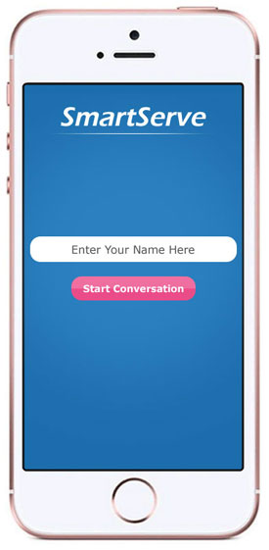
Screen 2 – Home Screen
User will be prompted to enter name and start conversation on this screen.
3

Slide 4
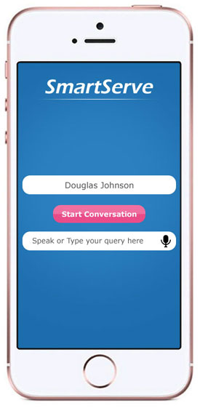
Screen 3 – Conversation Screen
A little text area will come at bottom post that. User can either key in or speak something on mic.
4

Slide 5
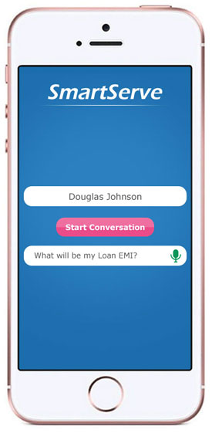
Screen 4 – Conversation Screen
The text corresponding to User’s voice which is interpreted by Watson (in case mic is used) will be shown pre-populated and the result of the query returned by Watson will be speak-ed out by App.
5

Slide 6
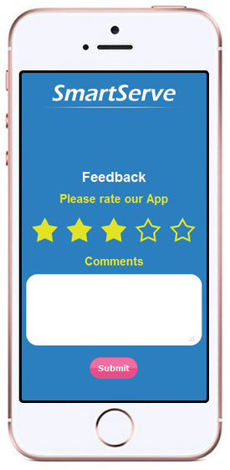
Screen 5 – Feedback Screen
On shaking the phone this feedback screen will open.
6

